Slide 1
Implementing
Architectures
Software Architecture
Lecture 15

Slide 2
Objectives
Concepts
  Implementation as a mapping problem
  Architecture implementation frameworks
  Evaluating frameworks
  Relationships between middleware, frameworks, component models
  Building new frameworks
  Concurrency and generative technologies
  Ensuring architecture-to-implementation consistency
Examples
  Different frameworks for pipe-and-filter
  Different frameworks for the C2 style
Application
  Implementing Lunar Lander in different frameworks

Slide 3
Objectives
Concepts
  Implementation as a mapping problem
  Architecture implementation frameworks
  Evaluating frameworks
  Relationships between middleware, frameworks, component models
  Building new frameworks
  Concurrency and generative technologies
  Ensuring architecture-to-implementation consistency
Examples
  Different frameworks for pipe-and-filter
  Different frameworks for the C2 style
Application
  Implementing Lunar Lander in different frameworks

Slide 4
The Mapping Problem
Implementation is the one phase of software engineering that is not optional
Architecture-based development provides a unique twist on the classic problem
  It becomes, in large measure, a mapping activity
Maintaining mapping means ensuring that our architectural intent is reflected in our constructed systems
Design
Decisions
Implementation
Artifacts

Slide 5
Common Element Mapping
Components and Connectors
  Partitions of application computation and communication functionality
  Modules, packages, libraries, classes, explicit components/connectors in middleware
Interfaces
  Programming-language level interfaces (e.g., APIs/function or method signatures) are common
  State machines or protocols are harder to map

Slide 6
Common Element Mapping (cont’d)
Configurations
  Interconnections, references, or dependencies between functional partitions
  May be implicit in the implementation
  May be externally specified through a MIL and enabled through middleware
  May involve use of reflection
Design rationale
  Often does not appear directly in implementation
  Retained in comments and other documentation

Slide 7
Common Element Mapping (cont’d)
Dynamic Properties (e.g., behavior):
  Usually translate to algorithms of some sort
  Mapping strategy depends on how the behaviors are specified and what translations are available
  Some behavioral specifications are more useful for generating analyses or testing plans
Non-Functional Properties
  Extremely difficult to do since non-functional properties are abstract and implementations are concrete
  Achieved through a combination of human-centric strategies like inspections, reviews, focus groups, user studies, beta testing, and so on

Slide 8
One-Way vs. Round Trip Mapping
Architectures inevitably change after implementation begins
  For maintenance purposes
  Because of time pressures
  Because of new information
Implementations can be a source of new information
  We learn more about the feasibility of our designs when we implement
  We also learn how to optimize them
Design
Decisions
Implementation
Artifacts

Slide 9
One-Way vs. Round Trip Mapping (cont’d)
Keeping the two in sync is a difficult technical and managerial problem
  Places where strong mappings are not present are often the first to diverge
One-way mappings are easier
  Must be able to understand impact on implementation for an architectural design decision or change
Two way mappings require more insight
  Must understand how a change in the implementation impacts architecture-level design decisions

Slide 10
One-Way vs. Round Trip Mapping (cont’d)
One strategy: limit changes
  If all system changes must be done to the architecture first, only one-way mappings are needed
  Works very well if many generative technologies in use
  Often hard to control in practice; introduces process delays and limits implementer freedom
Alternative: allow changes in either architecture or implementation
  Requires round-trip mappings and maintenance strategies
  Can be assisted (to a point) with automated tools

Slide 11
Architecture Implementation Frameworks
Ideal approach: develop architecture based on a known style, select technologies that provide implementation support for each architectural element
OO Class
Design
Decisions
Software
Library
Database

Slide 12
Architecture Implementation Frameworks
This is rarely easy or trivial
  Few programming languages have explicit support for architecture-level constructs
  Support infrastructure (libraries, operating systems, etc.) also has its own sets of concepts, metaphors, and rules
To mitigate these mismatches, we leverage an architecture implementation framework

Slide 13
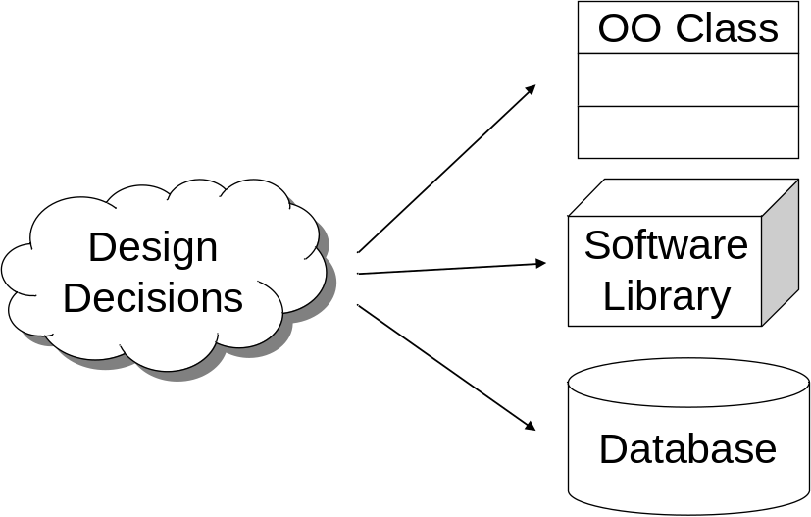
Architecture Implementation Frameworks
Definition: An architecture implementation framework is a piece of software that acts as a bridge between a particular architectural style and a set of implementation technologies. It provides key elements of the architectural style in code, in a way that assists developers in implementing systems that conform to the prescriptions and constraints of the style.
F
r
a
m
e
w
o
r
k

Slide 14

Canonical Example
The standard I/O (‘stdio’) framework in UNIX and other operating systems
  Perhaps the most prevalent framework in use today
  Style supported: pipe-and-filter
  Implementation technologies supported: concurrent process-oriented operating system, (generally) non-concurrent language like C
Software Architecture: Foundations, Theory, and Practice; Richard N. Taylor, Nenad Medvidovic, and Eric M. Dashofy; ｩ 2008 John Wiley & Sons, Inc. Reprinted with permission.

Slide 15
More on Frameworks
Frameworks are meant to assist developers in following a style
  But generally do not constrain developers from violating a style if they really want to
Developing applications in a target style does not require a framework
  But if you follow good software engineering practices, you’ll probably end up developing one anyway
Frameworks are generally considered as underlying infrastructure or substrates from an architectural perspective
  You won’t usually see the framework show up in an architectural model, e.g., as a component

Slide 16
Same Style, Different Frameworks
For a given style, there is no one perfect architecture framework
  Different target implementation technologies induce different frameworks
    stdio vs. iostream vs. java.io
Even in the same (style/target technology) groupings, different frameworks exist due to different qualitative properties of frameworks
  java.io vs. java.nio
  Various C2-style frameworks in Java

Slide 17
Evaluating Frameworks
Can draw out some of the qualitative properties just mentioned
Platform support
  Target language, operating system, other technologies
Fidelity
  How much style-specific support is provided by the framework?
    Many frameworks are more general than one target style or focus on a subset of the style rules
  How much enforcement is provided?

Slide 18
Evaluating Frameworks (cont’d)
Matching Assumptions
  Styles impose constraints on the target architecture/application
  Frameworks can induce constraints as well
    E.g., startup order, communication patterns …
  To what extent does the framework make too many (or too few) assumptions?
Efficiency
  Frameworks pervade target applications and can potentially get involved in any interaction
  To what extent does the framework limit its slowdown and provide help to improve efficiency if possible (consider buffering in stdio)?

Slide 19
Evaluating Frameworks (cont’d)
Other quality considerations
  Nearly every other software quality can affect framework evaluation and selection
    Size
    Cost
    Ease of use
    Reliability
    Robustness
    Availability of source code
    Portability
    Long-term maintainability and support

Slide 20
Middleware and Component Models
This may all sound similar to various kinds of middleware/component frameworks
  CORBA, COM/DCOM, JavaBeans, .NET, Java Message Service (JMS), etc.
They are closely related
  Both provide developers with services not available in the underlying OS/language
  CORBA provides well-defined interfaces, portability, remote procedure call…
  JavaBeans provides a standardized packaging framework (the bean) with new kinds of introspection and binding

Slide 21
Middleware and Component Models (cont’d)
Indeed, architecture implementation frameworks are forms of middleware
  There’s a subtle difference in how they emerge and develop
  Middleware generally evolves based on a set of services that the developers want to have available
    E.g., CORBA: Support for language heterogeneity, network transparency, portability
  Frameworks generally evolve based on a particular architectural style that developers want to use
Why is this important?

Slide 22
Middleware and Component Models (cont’d)
By focusing on services, middleware developers often make other decisions that substantially impact architecture
E.g., in supporting network transparency and language heterogeneity, CORBA uses RPC
  But is RPC necessary for these services or is it just an enabling technique?
In a very real way, middleware induces an architectural style
  CORBA induces the ‘distributed objects’ style
  JMS induces a distributed implicit invocation style
Understanding these implications is essential for not having major problems when the tail wags the dog!

Slide 23
Resolving Mismatches
A style is chosen first, but the middleware selected for implementation does not support (or contradicts) that style
A middleware is chosen first (or independently) and has undue influence on the architectural style used
Strategies
  Change or adapt the style
  Change the middleware selected
  Develop glue code
  Leverage parts of the middleware
  and ignore others
  Hide the middleware in components/connectors
Use the middleware
as the basis for
a framework

Slide 24
Hiding Middleware in Connectors
Comp 1
Comp 1
Architecture
(thread)
Async Event
RPC
(thread)
Implementation
Comp 2
Comp 2

Slide 25
Building a New Framework
Occasionally, you need a new framework
  The architectural style in use is novel
  The architectural style is not novel but it is being implemented on a platform for which no framework exists
  The architectural style is not novel and frameworks exist for the target platform, but the existing frameworks are inadequate
Good framework development is extremely difficult
  Frameworks pervade nearly every aspect of your system
  Making changes to frameworks often means changing the entire system
  A task for experienced developers/architects

Slide 26
New Framework Guidelines
Understand the target style first
  Enumerate all the rules and constraints in concrete terms
  Provide example design patterns and corner cases
Limit the framework to the rules and constraints of the style
  Do not let a particular target application’s needs creep into the framework
  “Rule of three” for applications

Slide 27
New Framework Guidelines (cont’d)
Choose the framework scope
  A framework does not necessarily have to implement all possible stylistic advantages (e.g., dynamism or distribution)
Avoid over-engineering
  Don’t add capabilities simply because they are clever or “cool”, especially if known target applications won’t use them
  These often add complexity and reduce performance

Slide 28
New Framework Guidelines (cont’d)
Limit overhead for application developers
  Every framework induces some overhead (classes must inherit from framework base classes, communication mechanisms limited)
  Try to put as little overhead as possible on framework users
Develop strategies and patterns for legacy systems and components
  Almost every large application will need to include elements that were not built to work with a target framework
  Develop strategies for incorporating and wrapping these

Slide 29
Concurrency
Concurrency is one of the most difficult concerns to address in implementation
  Introduction of subtle bugs: deadlock, race conditions…
  Another topic on which there are entire books written
Concurrency is often an architecture-level concern
  Decisions can be made at the architectural level
  Done carefully, much concurrency management can be embedded into the architecture framework
Consider our earlier example, or how pipe-and-filter architectures are made concurrent without direct user involvement

Slide 30
Generative Technologies
With a sufficiently detailed architectural model, various implementation artifacts can be generated
  Entire system implementations
    Requires extremely detailed models including behavioral specifications
    More feasible in domain-specific contexts
  Skeletons or interfaces
    With detailed structure and interface specifications
  Compositions (e.g., glue code)
    With sufficient data about bindings between two elements

Slide 31
Maintaining Consistency
Strategies for maintaining one-way or round-trip mappings
  Create and maintain traceability links from architectural implementation elements
    Explicit links in a database, in architectural models, in code comments can all help with consistency checking
  Make the architectural model part of the implementation
    When the model changes, the implementation adapts automatically
    May involve “internal generation”
  Generate some or all of the implementation from the architecture

